Slide 1

Mini Project-I Presentation
T.E. (Computer) Sem - V
Lokmanya Tilak College of Engineering, Navi Mumbai
Computer Engineering
2022-23

Slide 2

CAR RENTAL SYSTEM
Group members name & Roll No
AIML 07 BHOR AYUSH RAVINDRA.
AIML 21 KHANOLKAR VARUN VIJAY .
AIML 51 SHAIKH PARVEZ SHABBIR.
AIML 65 UMARJI PRASAD MALLIKARJUN.
Name of Project Guide: Prof. Kavita Rathi .

Slide 3
Presentation Outline
Abstract
Introduction
Literature Survey
Limitation of Existing system
Problem Statement
Scope
Proposed System
Conclusion
References

Slide 4
ABSTRACT
A car rental service is wishing to have a user interface that will allow their customers to view the models, descriptions and prices of different cars available. The user has the ability to register and log in to the web site and see their rental plan.
The web site will be responsive, allowing for the customer to view it on any device, from tablets to mobile phones and desktop computers.
The administrator will also be able to login through the same from but have the ability to add/remove new car rentals, change prices, and so on. Potential customers should be able to view all the cars available to rent even without logging in .

Slide 5
INTRODUCTION
Car rental or car hire agencies are private companies that provide short time leasing vehicles for a specified time with a fee to their customers. Car rental service increasingly becomes the preferred option for most of the people .
The project is designed to help people utilize transport effectively.
Our Car rental system helps in making this an easier, hassle-free and enjoyable experience to acquire and use a car as per ones needs.

Slide 6
LITERATURE SURVEY
Sr. No | Authors | Title of the paper & year of publ.(Old to recent ) | Major contributions
1 | Darius Tanz | Car Rental Knowledge and Customers 2013 | Analysis to establish the real-world requirement
2 | Jia ning luo | Anonymous Car Rental System 2014 | Implementation of program on server
3 | Mallikarjun Rao | Enhancement of Rental System 2020 | Necessitates a cost based analysis

Slide 7
LIMITATION OF EXISTING SYTEM
The Manual car rental system provides services only during office hours.
Cars that provide difficulties to rent out are normally advertised in local or national newspaper.it involves a lot of paper work and consume time.
Unawareness of vehicle’s condition.
Car tracking.

Slide 8
PROBLEM STATEMENT
There are some customers who faced a problem in choosing car to be rented which suitable with some of the important requirements.
1. To rent a car a prospective renter must first go to the nearest office to register as a client.
2. Cars that provide difficulties to rent out are normally advertised in local or national newspaper. It involves a lot of paper work and consume time.

Slide 9
SCOPE
Time saving - Getting around with a car is faster than public transport. Less time spent for transportation .
Availability - It is almost impossible to find a taxi in most cities and at time.
Maintenance - User does not have to spend any money on maintenance as it will be managed by the owner.

Slide 10
PROPOSED SYSTEM
Enable the user to rent a vehicle.
Data regarding the rental cars are stored in MySQL database.
This Car Rental System project is designed to aid the car rental company to enable renting of cars through an online system.
User shall be able to make bookings according to requirements
It saves time and labour.
.

Slide 11
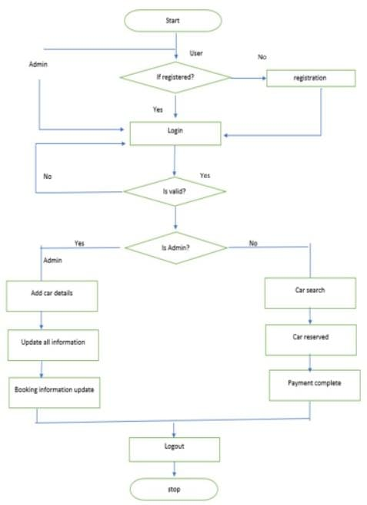

Slide 12
CONCLUSION
Hassle free renting can be provided.
The data is stored in a centralized manner and can be controlled/monitored by the operational manager and owner.
Through this application we are trying to promote renting out products used on a daily basis .

Slide 13
REFERENCES
Anonymous Car Rental System Based on NFC IN SPEC Accession number: 13769540
Automation system of vehicle requisition in public sector, Rwanda. IEEE ICIS 2016: 978-1-5090-0806-3/16
Thakur, A., & Dhiman, K. (2021). Chat Room Using HTML, PHP, CSS, JS, AJAX. International Research Journal of Engineering and Technology (IRJET), 08(June), 1948–1951. https://doi.org/https://doi.org/10.6084/m9.figshare.14869167
Ieeexplore.ieee.org
Irjet.net
academia.edu

Slide 14
Thank You!

